Slide 1
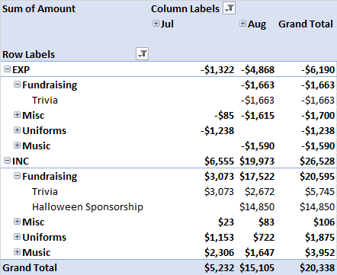
FINANCIAL POSITION
Strong financial position - $85k in bank
Majority of sponsorship invoice have been paid
Strong start to the year with Trivia fundraising as well

Slide 2
DRAFT ANNUAL BUDGET

Slide 3
FUNDING REQUESTS AND
REQUIRED DECISIONS
Requested Item | Stream | Benefit T/F | Value | Budgeted? | On Notice | Final
Lion King Script |  |  | $1k |  | Y
Previously Approved | Stream | Benefit T/F | Value | Budgeted? | On Notice | Final
Furniture – Aug Approval | Matched by school $5k |  | $10k |  | Y
Furniture – Jun/Jul Approval | Matched by school $15k |  | $30k |  | Y

